Slide 1

Sadikul Haque Sadi
BSSE 1003
Exam Roll 61007

Slide 2

Company Profile
Founded in 1999
Outsourcing based software developing entity
Provides global software solution
35-40 developers

Slide 3

Working Experience
Online Office
Flexible working hour
No restricted deadlines
Friendly and Co-operative
Appreciation & Gratitude

Slide 4

Project Work
Overview
Project Name & Description | Not sharable
Team Size | 5
Team member’s designation | Team Lead(1), Software Engineers(3), Software QA engineer(1)
Technology Used | Microsoft ASP.NET Core, C#, jQuery, TypeScript, MS Power BI, SQL Server
Deployment | Microsoft Azure

Slide 5



My Contribution
Not involved directly
R & D Work

Slide 6

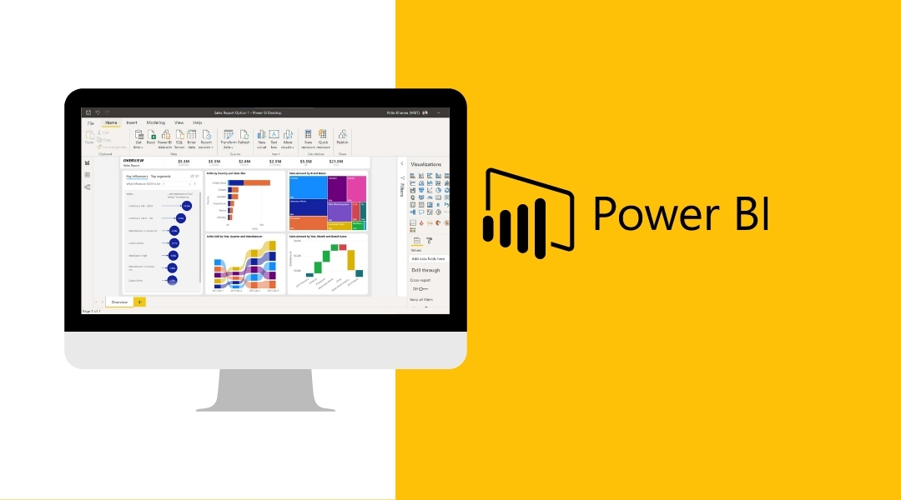

Technology

Slide 7

What is Power BI?
A data analytics tool
Data modeling & Visualizing tool
Report building utility

Slide 8

My Contribution
Learning phase
Report Creating & Data Visualizing
R & D Work
Power Query
DAX writing
Report Publishing & Embedding

Slide 9

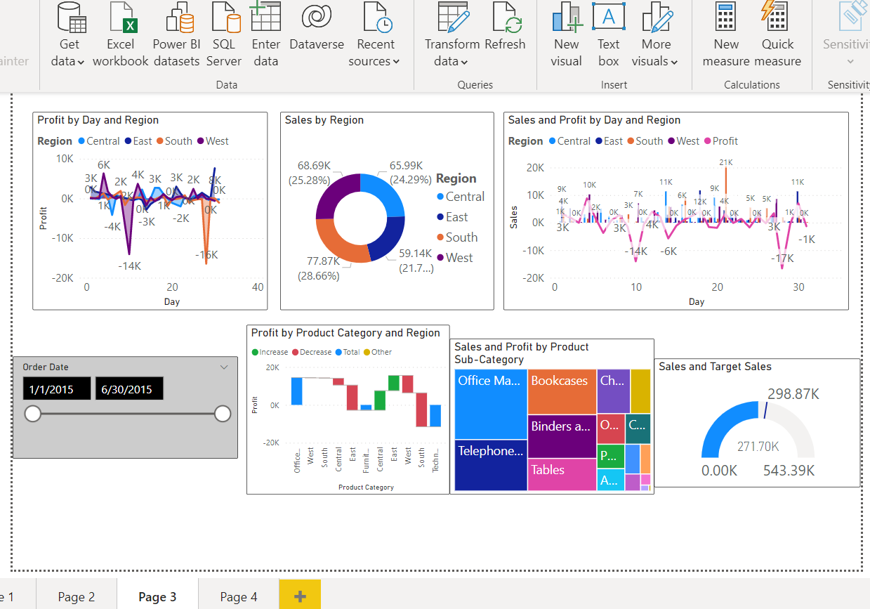
Data Visualization

Slide 10

Data Transformation
Power Query Editor
Data Preprocessing
User Interface
Structuring Raw Data
M formula language

Slide 11
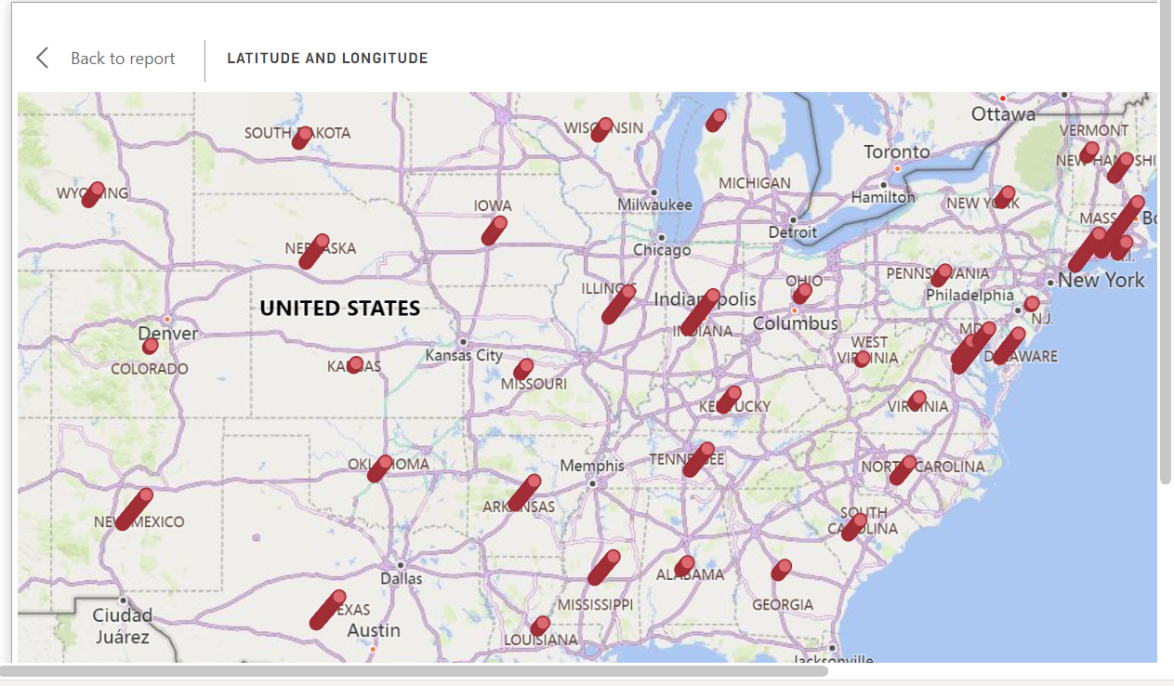
Data Transformation
Dot Density Map

Slide 12
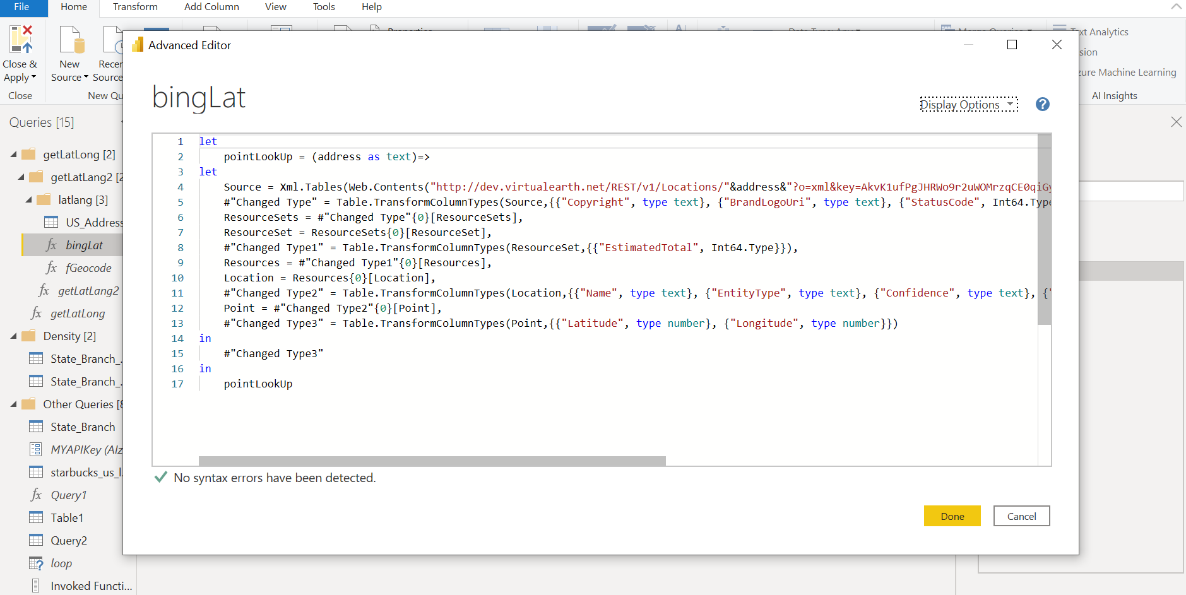
Power Query
M formula language

Slide 13
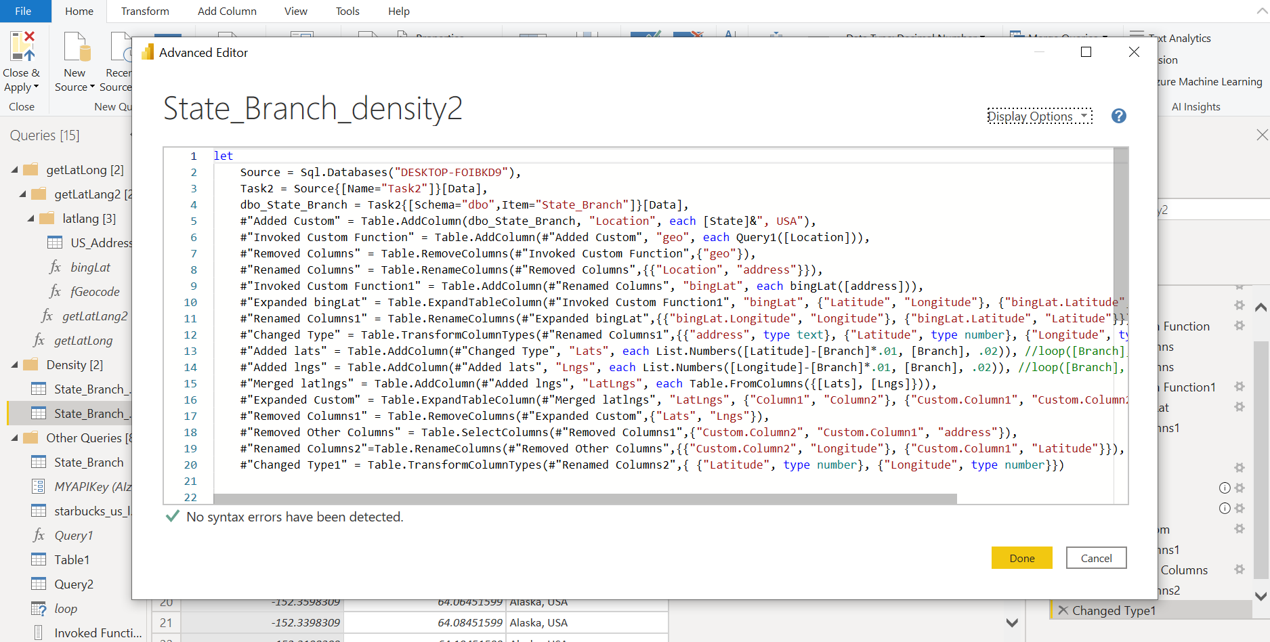
Power Query
M formula language

Slide 14

Data Modelling
DAX - Data Analysis Expression
Calculated columns
Functional Language
Built in functions
Measures
Custom tables
Create new information

Slide 15
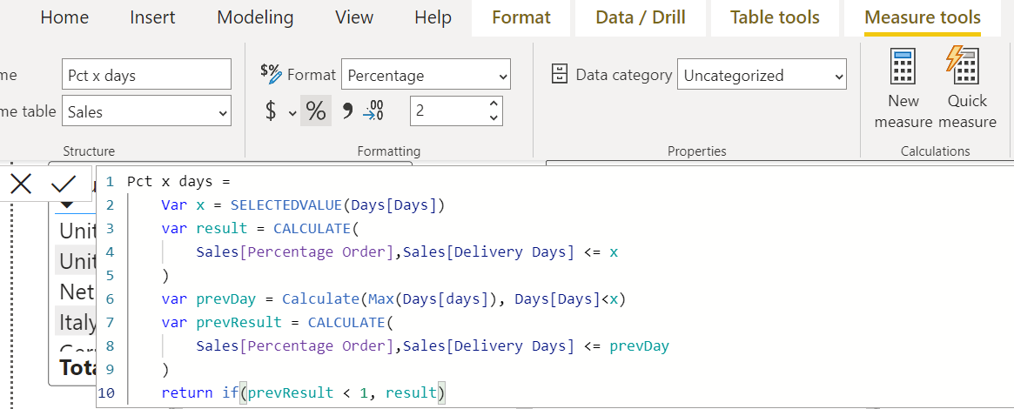
Data Modelling
DAX -
Data Analysis Expression

Slide 16
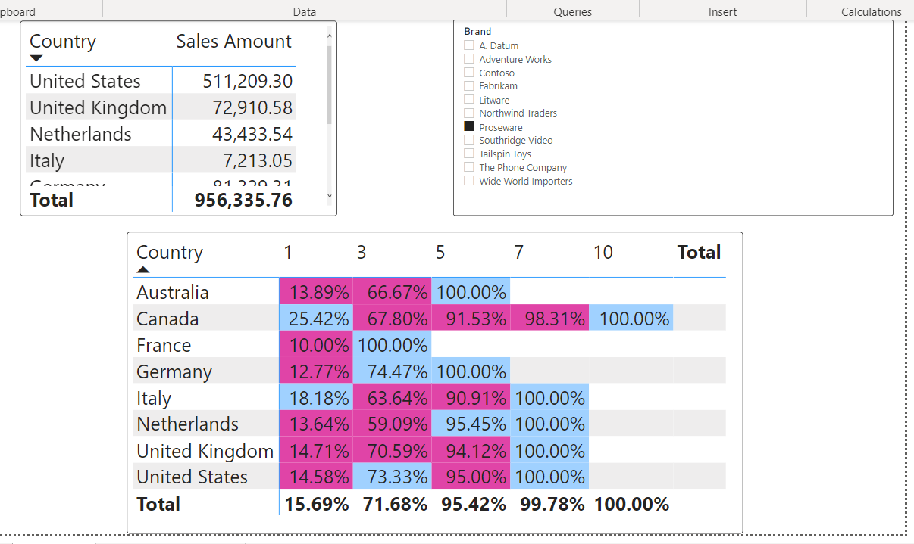
Data Modelling
DAX -
Data Analysis Expression

Slide 17
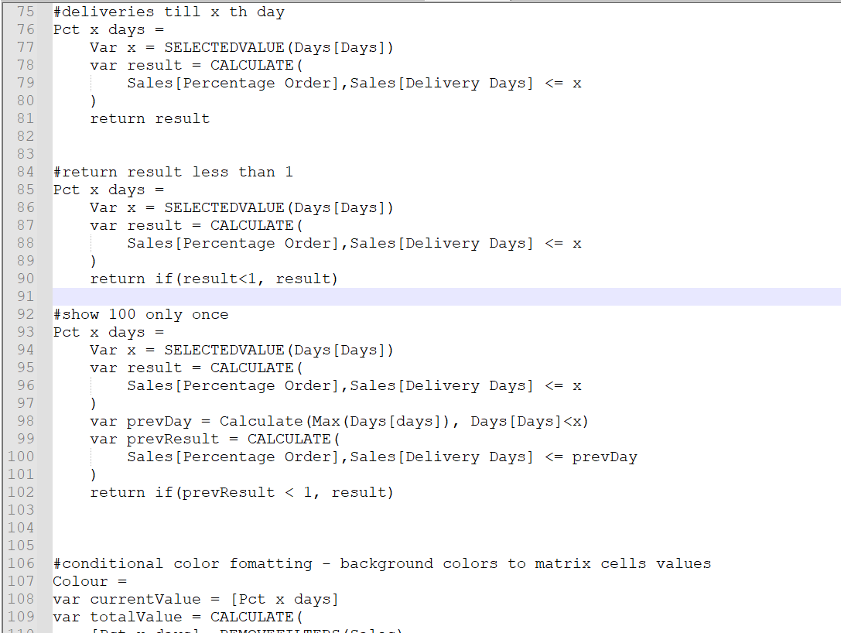
Data Modelling
DAX -
Data Analysis Expression

Slide 18

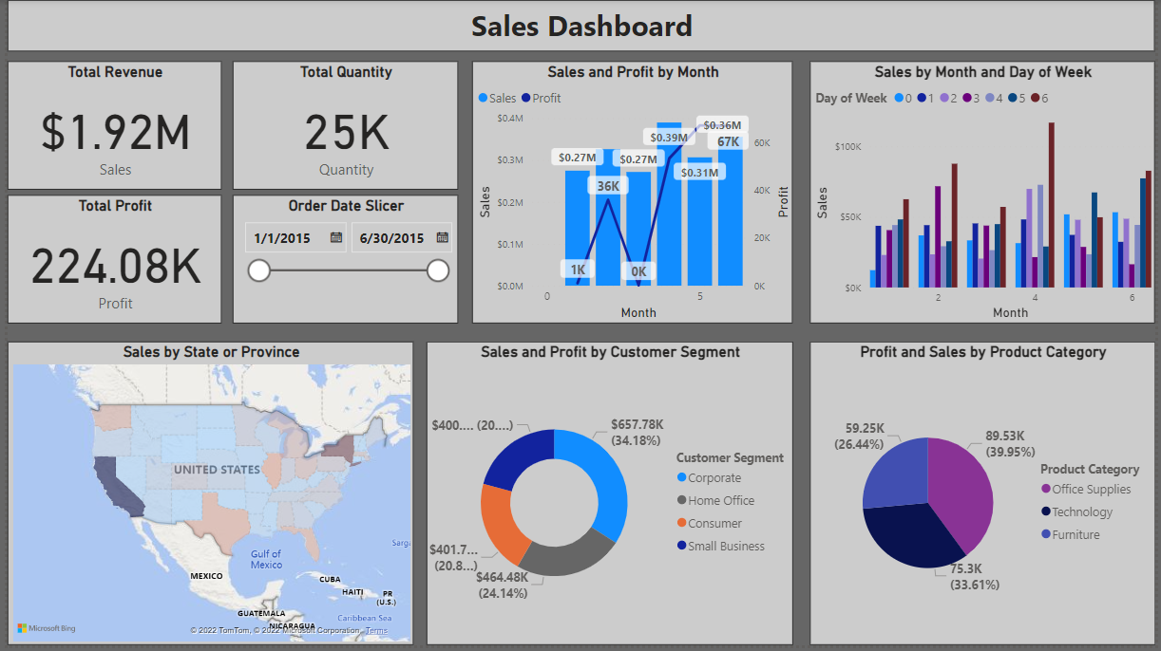
Report Building
Report
&
Dashboard

Slide 19
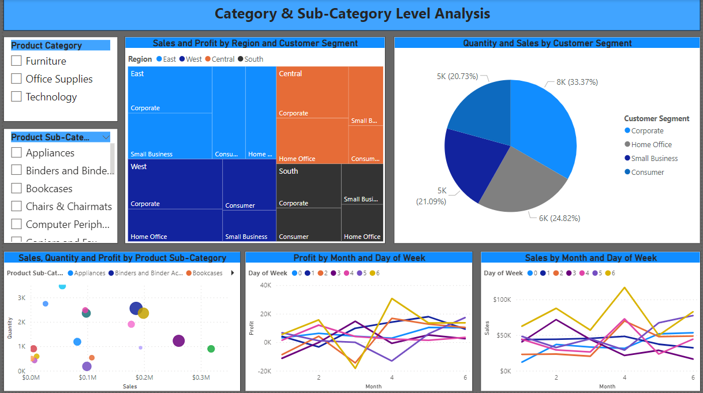
Report Building
Report
&
Dashboard
Report
&
Dashboard

Slide 20
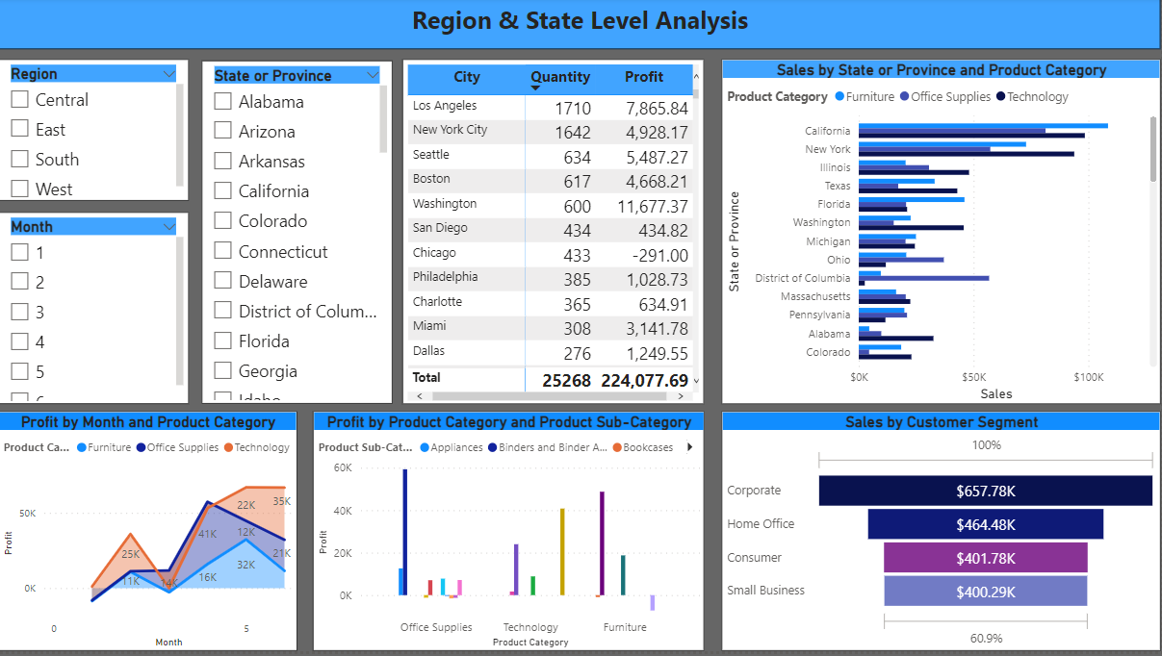
Report Building
Report
&
Dashboard

Slide 21
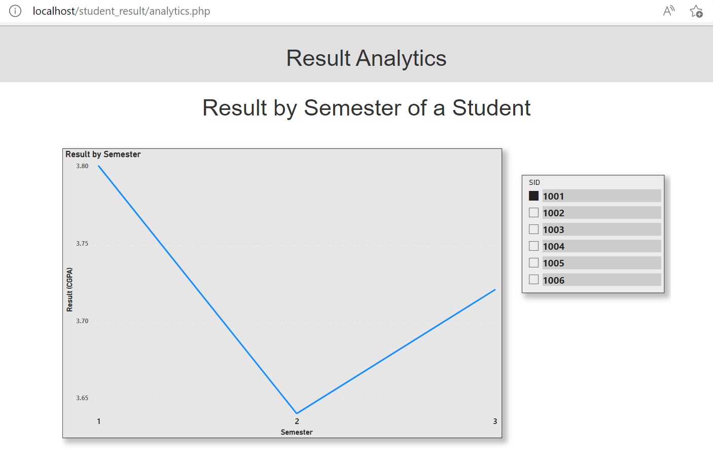
Report Publishing
Report
Embedding
In a
Website

Slide 22
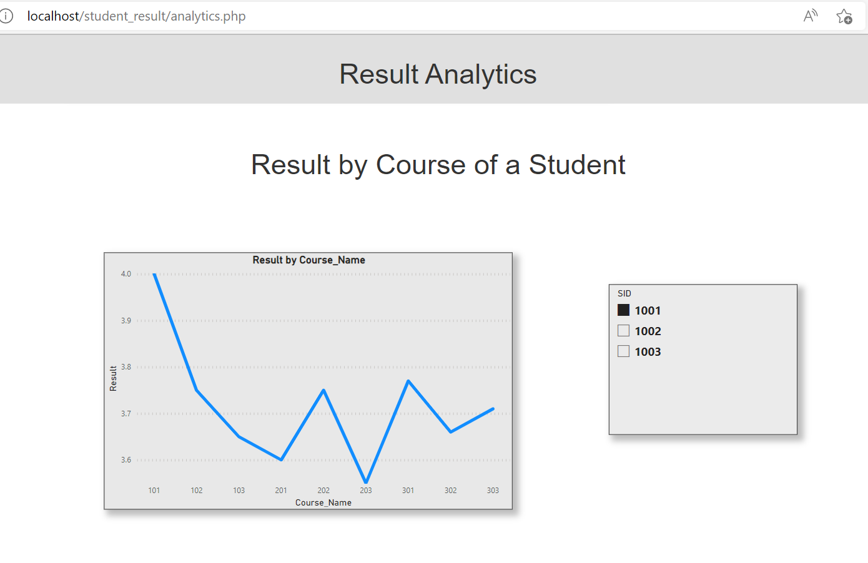
Report Publishing
Report
Embedding
In a
Website

Slide 23


Soft Skills
Communication skill
Negotiating skill
Time management
Self-esteem

Slide 24

Q & A

Slide 25
Thank you

